Slide 1
Why Python Uses Self?
DVT101 – Lecture 15
- By Dataverse Tutorials

Slide 2
Why Does Python Use self?
What is self in Python?
Why every class method needs self
Difference between object and class
Beginner confusion explained simply

Slide 3
What is self?
self is not a keyword
It represents the current object
Refers to instance of the class
Used to access instance variables & methods

Slide 4
Internal Working: How Python Uses self
Method call internally converts
obj.method() → Class.method(obj)
self binds data to object
Enables multiple instances

Slide 5
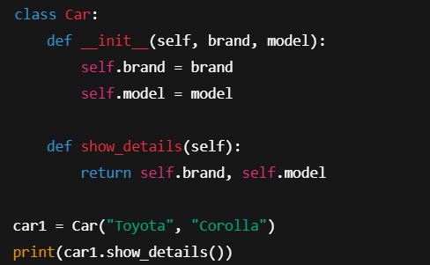
Example 1: Car Class
__init__ initializes object
self.brand, self.model store data
display() accesses same object data

Slide 6
Why Python Uses self
Explicit is better than implicit
Improves readability
Avoids confusion in inheritance
Gives developer full control

Slide 7
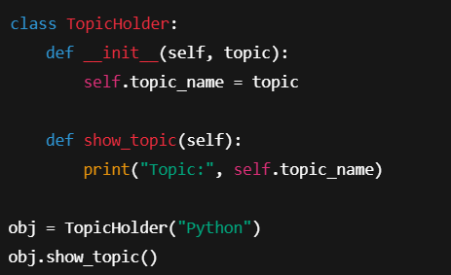
Example 2: Object Initialization
self represents the current object (instance)
Used to access instance variables and methods
Passed automatically by Python during method call
Makes Object-Oriented Programming explicit and clear

Slide 8
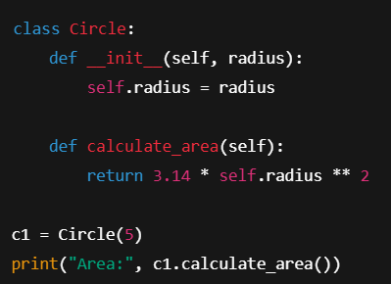
Example 3: Circle Area Calculation
Using self to store instance-specific data
Mathematical computation using object attributes
How self ensures correct value per object
Real-world analogy of multiple objects

Slide 9
Real-World & Industry Use
Used in Machine Learning models
Used in Web Development frameworks
Used in large-scale software systems
Core concept for scalable code

Slide 10
Summary & Key Takeaways
self represents current object
Mandatory for instance methods
Enables clean OOP design
Core Python concept

Slide 11


